Slide 1

SOFTWARE ENGINEERING AND PROJECT MANAGEMENT (CSE 227)
Department of Computer Science and Engineering
School of Engineering,
PRESIDENCY UNIVERSITY

Slide 2
TEXT BOOK AND REFERENCE BOOKS
REFERENCE MATERIALS:
Text book(s):
Roger S. Pressman, “Software Engineering – A Practitioner’s Approach”, VII Edition, McGraw-Hill, 2017.
Bob Hughes, Mike Cotterell, Rajib Mall, “Software Project Management”, VI Edition, McGraw-Hill, 2018.
Reference book(s):
Ian Sommerville, “Software Engineering”, IX Edition, Pearson Education Asia, 2011.
Rajib Mall, “Fundamentals of Software Engineering”, VI Edition, PHI learning private limited, 2014.

Slide 3
Assessment Schedule
Sl.no | Assessment type | Contents | Course outcome Number | Duration In Hours | Marks | weightage | Venue, DATE &TIME
1 | Module Quiz I [Informal] | Modules 1 | CO1 | 1 | 10 | 5% | Announce Later
2 | Quiz II [Informal] | Modules 2 | CO2 | 1 | 10 | 5%
3 | Test-1 [Formal] | Modules 1 & 2 | CO1 CO2 | 1 | 40 | 20%
4 | Assignment | Module 3 | CO3 | 1 | 10 | 5%
5 | Test-2 [Formal] | Modules 3 & 4 | CO3 CO4 | 1 | 40 | 20%
6 | Case Study | Module 4 | CO4 | 1 | 10 | 5%
7 | End Term Exam [Formal] | Modules 1 – 4 | CO1-CO4 | 3 | 80 | 40%

Slide 4
CHAPTER 1 - CONTENTS
What is Software?
Nature of Software or Software characteristics
Software Application Domains
Legacy Software
Characteristics of WebApps
What is Software Engineering?
Layered Technology
Software Process Framework
Umbrella activities in the Software Process
Essence of Software Practice
Software Myths

Slide 5
1. What is Software?
Software is:
instructions (computer programs) that when executed provide desired features, function, and performance;
data structures that enable the programs to adequately manipulate information and
documentation that describes the operation and use of the programs.
Software plays a dual role of being a “product” and also a “vehicle for delivering a product”.

Slide 6
2. Nature of Software or Characteristics
Software is developed or engineered, it is not manufactured in the classical sense.
Software doesn't "wear out."
Although the industry is moving toward component-based construction, most software continues to be custom-built.

Slide 7
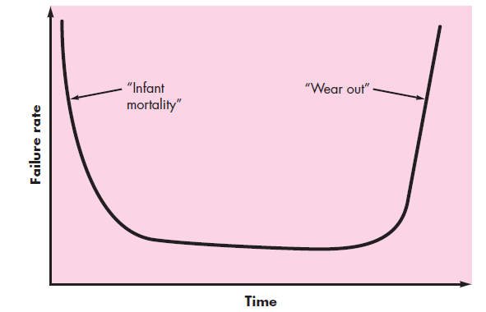
Hardware vs. Software Failures
Hardware components suffer from the cumulative effects of dust, vibration, abuse, temperature extremes
Design or
manufacturing defects
Changes in the software
Failure Curve for Hardware
Uncovering defects
Failure Curve for Software

Slide 8
3. Software Application Domains
System Software : Require heavy interaction with computer hardware
Ex: Operating Systems like Windows, Ubuntu, Android, iOS
Application Software : Stand alone programs that solve business need
Ex: Microsoft Office applications such as Word, Excel, PowerPoint
Engineering/Scientific software : Required for high performance scientific computing
Ex: Computer Aided Design (CAD) software, MATLAB, Julia
Embedded Software : Software that controls machines or devices
Ex: ATMs, Braking system in car, Key pad control in Microwave Oven

Slide 9
Software Application Domains
Product-line Software : Satisfies particular market segment
Ex: Walmart POS (Point of Sale) System, Metro POS System, Word
processing apps
Web Applications : Client-Server type of applications
Ex: Gmail, Google Docs, Facebook
AI Software : Expert Systems, Robotics, Pattern Recognition
Ex: Apple’s Siri (virtual assistant), IBM Watson, Google Maps

Slide 10
Software - New Categories
Open world computing - pervasive, distributed computing
Ubiquitous computing - wireless networks
Netsourcing - the Web as a computing engine
Open source - ”free” source code open to the computing community (a blessing, but also a potential curse!)
Also
Data mining
Grid computing
Cognitive machines
Software for nanotechnologies

Slide 11
4. Legacy Software
Legacy software are developed decades ago and have been continually modified to meet changes in business requirements and computing platforms.
Why must it change?
software must be adapted to meet the needs of new computing environments or technology.
software must be enhanced to implement new business requirements.
software must be extended to make it interoperable with other more modern systems or databases.
software must be re-architected to make it viable within a network environment.

Slide 12
5.1 Characteristics of WebApps - I
Network intensiveness. A WebApp resides on a network and must serve the needs of a diverse community of clients.
Concurrency. A large number of users may access the WebApp at one time.
Unpredictable load. The number of users of the WebApp may vary by orders of magnitude from day to day.
Performance. If a WebApp user must wait too long (for access, for server-side processing, for client-side formatting and display), he or she may decide to go elsewhere.
Availability. Although expectation of 100 percent availability is unreasonable, users of popular WebApps often demand access on a “24/7/365” basis.

Slide 13
5.2 Characteristics of WebApps - II
Data driven. The primary function of many WebApps is to use hypermedia to present text, graphics, audio, and video content to the end-user.
Continuous evolution. Unlike conventional application software that evolves over a series of planned, chronologically-spaced releases, Web applications evolve continuously.
Immediacy. Although immediacy—the compelling need to get software to market quickly—is a characteristic of many application domains, WebApps often exhibit a time to market that can be a matter of a few days or weeks.
Security. Because WebApps are available via network access, it is difficult, if not impossible, to limit the population of end-users who may access the application.
Aesthetics. An undeniable part of the appeal of a WebApp is its look and feel.

Slide 14
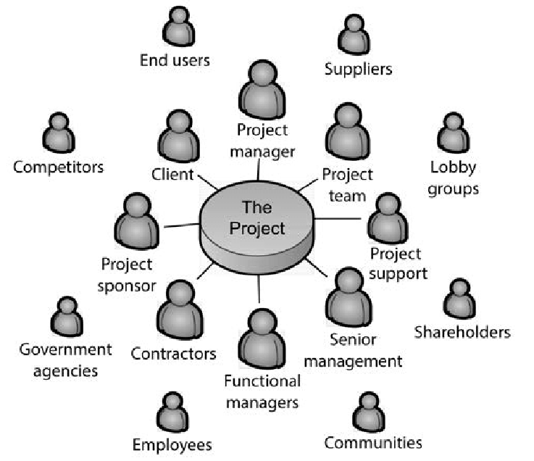
6. Software Engineering
The word Engineer means “To Build”

Slide 15
Software Engineering
Some realities:
a concerted effort should be made to understand the problem before a software solution is developed
design becomes a pivotal activity
software should exhibit high quality
software should be maintainable
Seminal definition by Fritz Bauer
[Software engineering is] the establishment and use of sound engineering principles in order to obtain economical software that is reliable and works efficiently on real machines.

Slide 16
Software Engineering
The IEEE definition:
Software Engineering: (1) The application of a systematic, disciplined, quantifiable approach to the development, operation, and maintenance of software; that is, the application of engineering to software.

Slide 17
Software Process
A process is a collection of activities, actions, and tasks that are performed when some work product is to be created.
An activity strives to achieve a broad objective (e.g., communication with stakeholders) and is applied regardless of the application domain, size of the project, complexity of the effort.
An action (e.g., architectural design) encompasses a set of tasks that produce a major work product (e.g., an architectural design model).
A task focuses on a small, but well-defined objective (e.g., conducting a unit test) that produces a tangible outcome.

Slide 18
7. A Layered Technology
tools
methods
process model
a “quality” focus
Software Engineering Layers

Slide 19
8. A Process Framework
Process framework
Framework activities
work tasks
work products
milestones & deliverables
QA checkpoints
Umbrella Activities

Slide 20
Framework Activities
Communication
Planning
Modeling
Analysis of requirements
Design
Construction
Code generation
Testing
Deployment

Slide 21
9. Umbrella Activities
Software project management
Formal technical reviews
Software quality assurance
Software configuration management
Work product preparation and production
Reusability management
Measurement
Risk management

Slide 22
Why Software Projects Fail?
Unrealistic or unarticulated project goals
Inaccurate estimates of needed resources
Badly defined system requirements
Poor reporting of the project's status
Unmanaged risks
Poor communication: clients, developers, & users
Use of immature technology
Inability to handle the project's complexity
Sloppy development practices
Poor project management
Stakeholder politics
Commercial pressures

Slide 23
10. The Essence of Software Practice
Polya suggests:
1. Understand the problem (communication and analysis).
2. Plan a solution (modeling and software design).
3. Carry out the plan (code generation).
4. Examine the result for accuracy (testing and quality assurance).

Slide 24
10.1 Understand the Problem
Who has a stake in the solution to the problem? That is, who are the stakeholders?
What are the unknowns? What data, functions, and features are required to properly solve the problem?
Can the problem be compartmentalized? Is it possible to represent smaller problems that may be easier to understand?
Can the problem be represented graphically? Can an analysis model be created?

Slide 25
10.2 Plan the Solution
Have you seen similar problems before? Are there patterns that are recognizable in a potential solution? Is there existing software that implements the data, functions, and features that are required?
Has a similar problem been solved? If so, are elements of the solution reusable?
Can subproblems be defined? If so, are solutions readily apparent for the subproblems?
Can you represent a solution in a manner that leads to effective implementation? Can a design model be created?

Slide 26
10.3 Carry Out the Plan
Does the solution conform to the plan? Is source code traceable to the design model?
Is each component part of the solution provably correct? Has the design and code been reviewed, or better, have correctness proofs been applied to algorithm?

Slide 27
10.4 Examine the Result
Is it possible to test each component part of the solution? Has a reasonable testing strategy been implemented?
Does the solution produce results that conform to the data, functions, and features that are required? Has the software been validated against all stakeholder requirements?

Slide 28
Hooker’s General Principles
Principle refers to “an important underlying law or assumption required in a system of thought”
1: The Reason It All Exists
2: KISS (Keep It Simple, Stupid!)
3: Maintain the Vision
4: What You Produce, Others Will Consume
5: Be Open to the Future
6: Plan Ahead for Reuse
7: Think!

Slide 29
11. Software Myths
Myths refer to “erroneous beliefs about software and the process that is used to build it”
We already have a book that’s full of standards and procedures for building software. Won’t that provide my people with everything they need to know?
If we get behind schedule, we can add more programmers and catch up (sometimes called the “Mongolian horde” concept).
If I decide to outsource the software project to a third party, I can just relax and let that firm build it.

Slide 30
Software Myths
Customer Myths
Software requirements continually change, but change can be easily accommodated because software is flexible.
Practitioner’s Myths
Once we write the program and get it to work, our job is done.
The only deliverable work product for a successful project is the working program.
Software engineering will make us create voluminous and unnecessary documentation and will invariably slow us down.

